Slide 1

Smart Strawberry Farm

Slide 2
Outlines:
Background
Problem
Objective
Proposed Method
Implementation

Slide 3
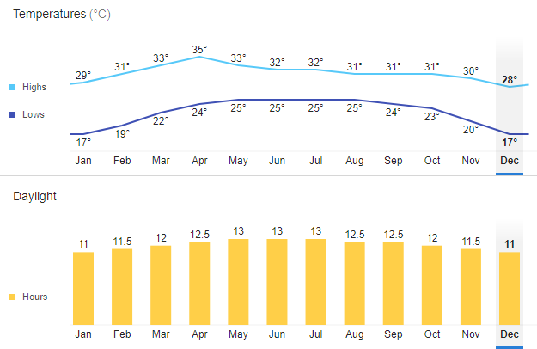
Background
Averaged Temperature in Vientiane
Generally, Strawberries enjoy a sunny in Colder weather location, but not a deep freeze
16.C or lower is best, while the strawberry flowers are forming
Once the fruit has formed, more heat is fine (18.C - 30.C)
Source: NOAA
Good period to plant strawberry

Slide 4
Problem
Averaged Temperature in Vientiane is not suitable to plant strawberries.
Planting strawberries inside a greenhouse with air conditioner can be a solution, but energy consumer is an issue.

Slide 5
Objectives
To create a control environment system for planting strawberries in lower energy consuming
To develop a demonstration of smart strawberry farm

Slide 6
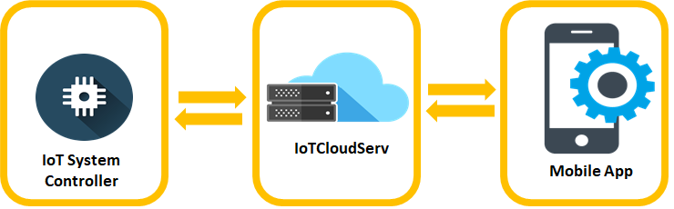
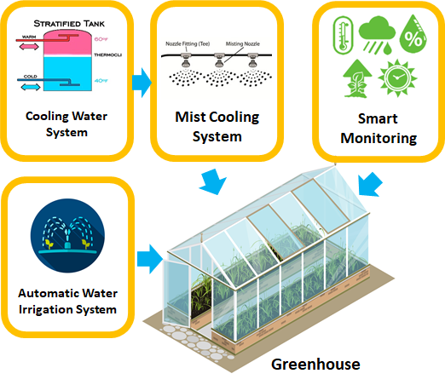
Proposed Method
Planting strawberries inside a greenhouse that able to control the temperature, humidity and moisture.
Using mist cooling system with underground cold water storage, expected for energy saving.
The temperature, humidity, soil moisture, light and PH are sensing for smart environment monitoring and controlling.

Slide 7
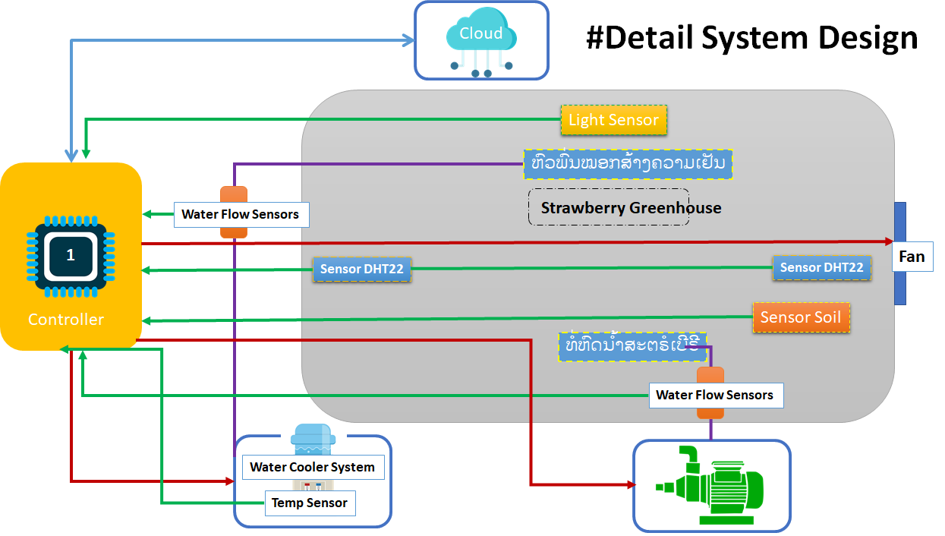
Implementation

Slide 8
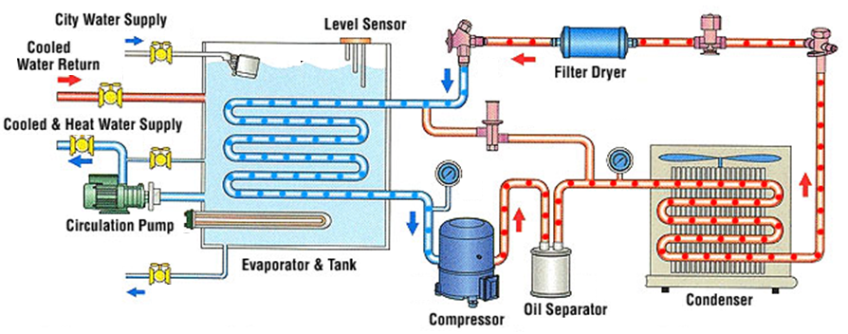
Water Cool Chiller System
Modified from Source: Ravti

Slide 9
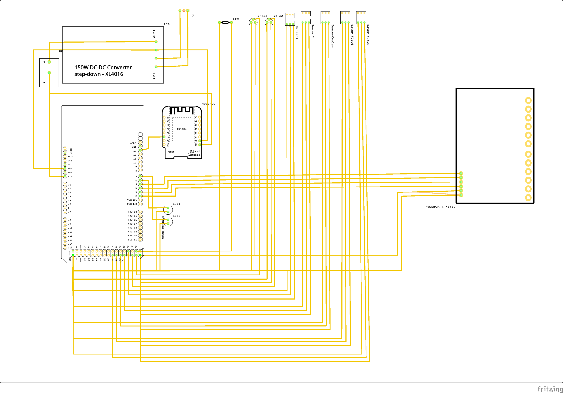
#Circuit System Design

Slide 10
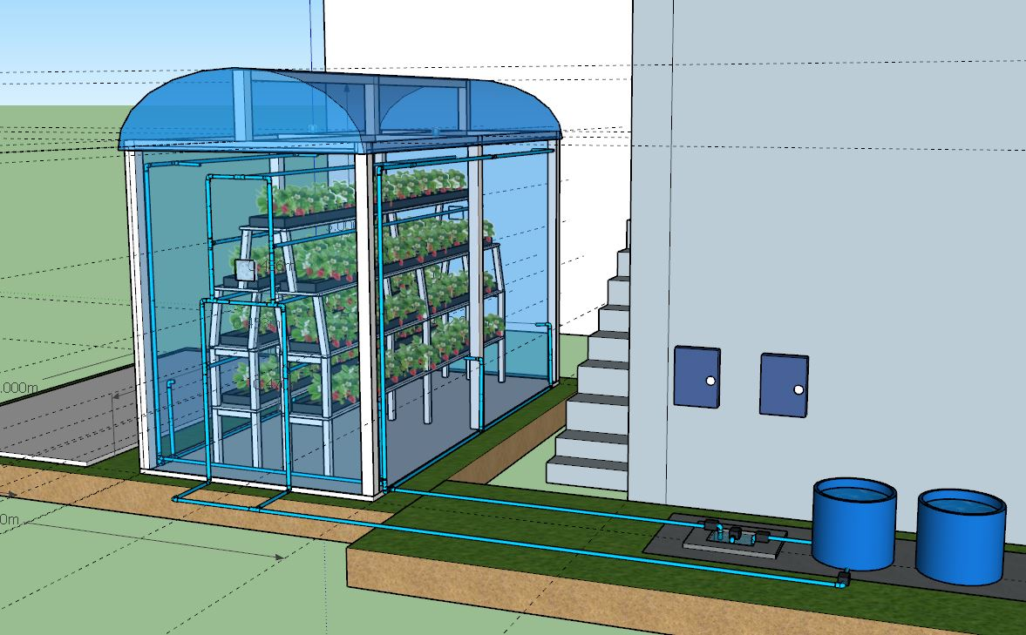
Box Controller

Slide 11
Thank You

